Slide 1
Introduction to AI with Custom Vision
Presented by:

Slide 2
“Artificial Intelligence is computers doing things that we would normally think of as intelligent in humans.”
Rick Barazza, Microsoft
Notes:
Our working definition.
It’s not just doing things that humans do. That’s not very hard. Humans do all sorts of dumb things that much simpler animals do. So we’re setting the bar higher than that. But not crazy high. We’re saying, AI is about carving out more and more pieces of intelligent behavior. And so by that definition AI is here today, and has been for a while now.
Before we talk about how Artificial Intelligence works, let’s talk briefly about Natural Intelligence.

Slide 3
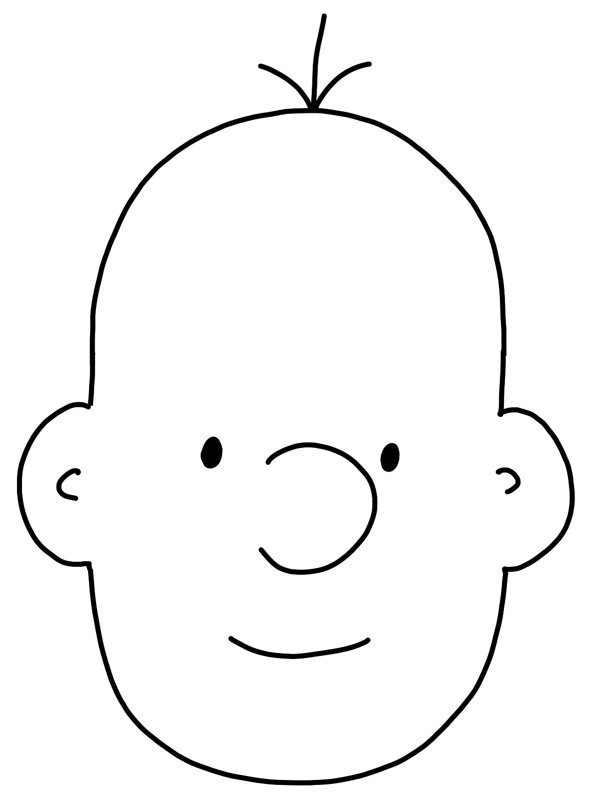
Model
Sensory
Input
Behavior
Notes:
You can compare artificial intelligence to how we as humans work:
We take in some form of sensory input. This could be something we see, hear, or otherwise.
We have a model in the form of our brain. It runs this input through its set of learnings from past experiences, and emits…
A behavior or response. This could be to ignore it, to laugh at a joke, to smile at a cute dog, or to take our hands off a hot stove.
If we think about how we as humans process information, it’s not that different from AI. We take input from the world – sights, sounds, information. We process that through our “model” – our brain – which has been trained by both nature and nurture. We then respond to that input in what would be termed behavior.

Slide 4
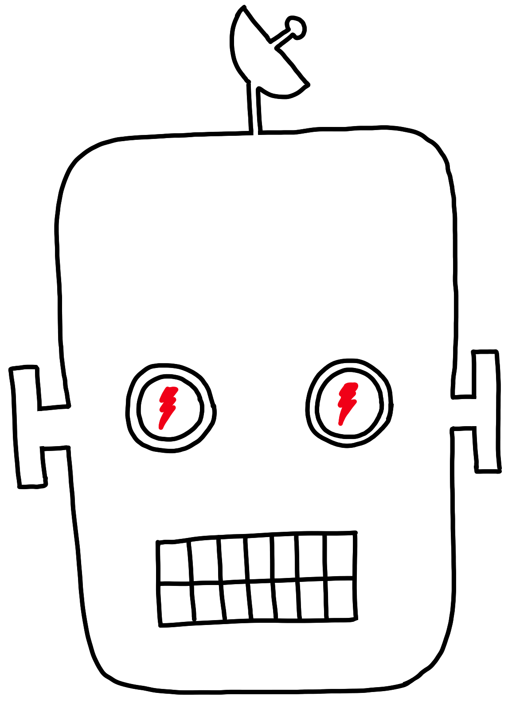
Model
Data
Answers
Notes:
With artificial intelligence, it’s much the same. Setting aside the potentially scary robot drawing, we feed our computer data. Our computer uses the model we’ve built, and then provides us answers.
We provide data through the use of a program, an image, user input, or other means
The scary robot uses its model to analyze the data and…
Responds with an answer

Slide 5
Algorithms
Diseased?
Notes:
Let’s explore how we might begin to build out a model to answer questions.
We start with a specific question – is a cell diseased?
We have a collection of cells
We mark these cells as diseased (red) or healthy) green
We then use different algorithms which can learn and understand patterns to help identify if a cell is diseased or healthy to train up our model
Now we get a new set of cells the model hasn’t seen before
The model then identifies which cells are healthy or diseased
If we look at the reality of the cells
And then the output we are going to notice things aren’t always perfect
We always need to adjust and understand that artificial intelligence will not give us perfection, but will provide the correct result a useful percentage of the time

Slide 6
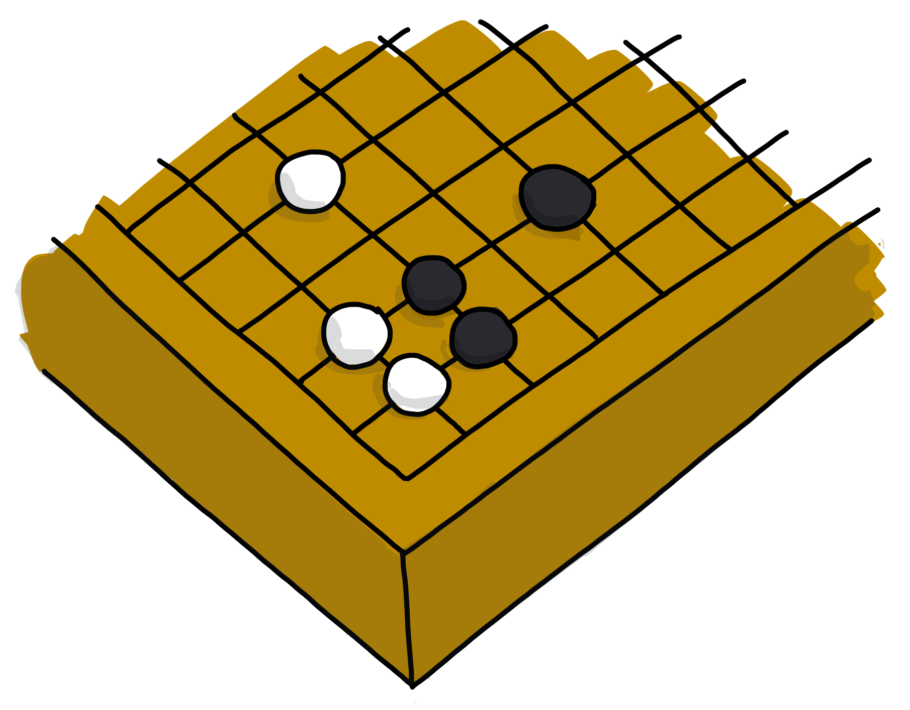
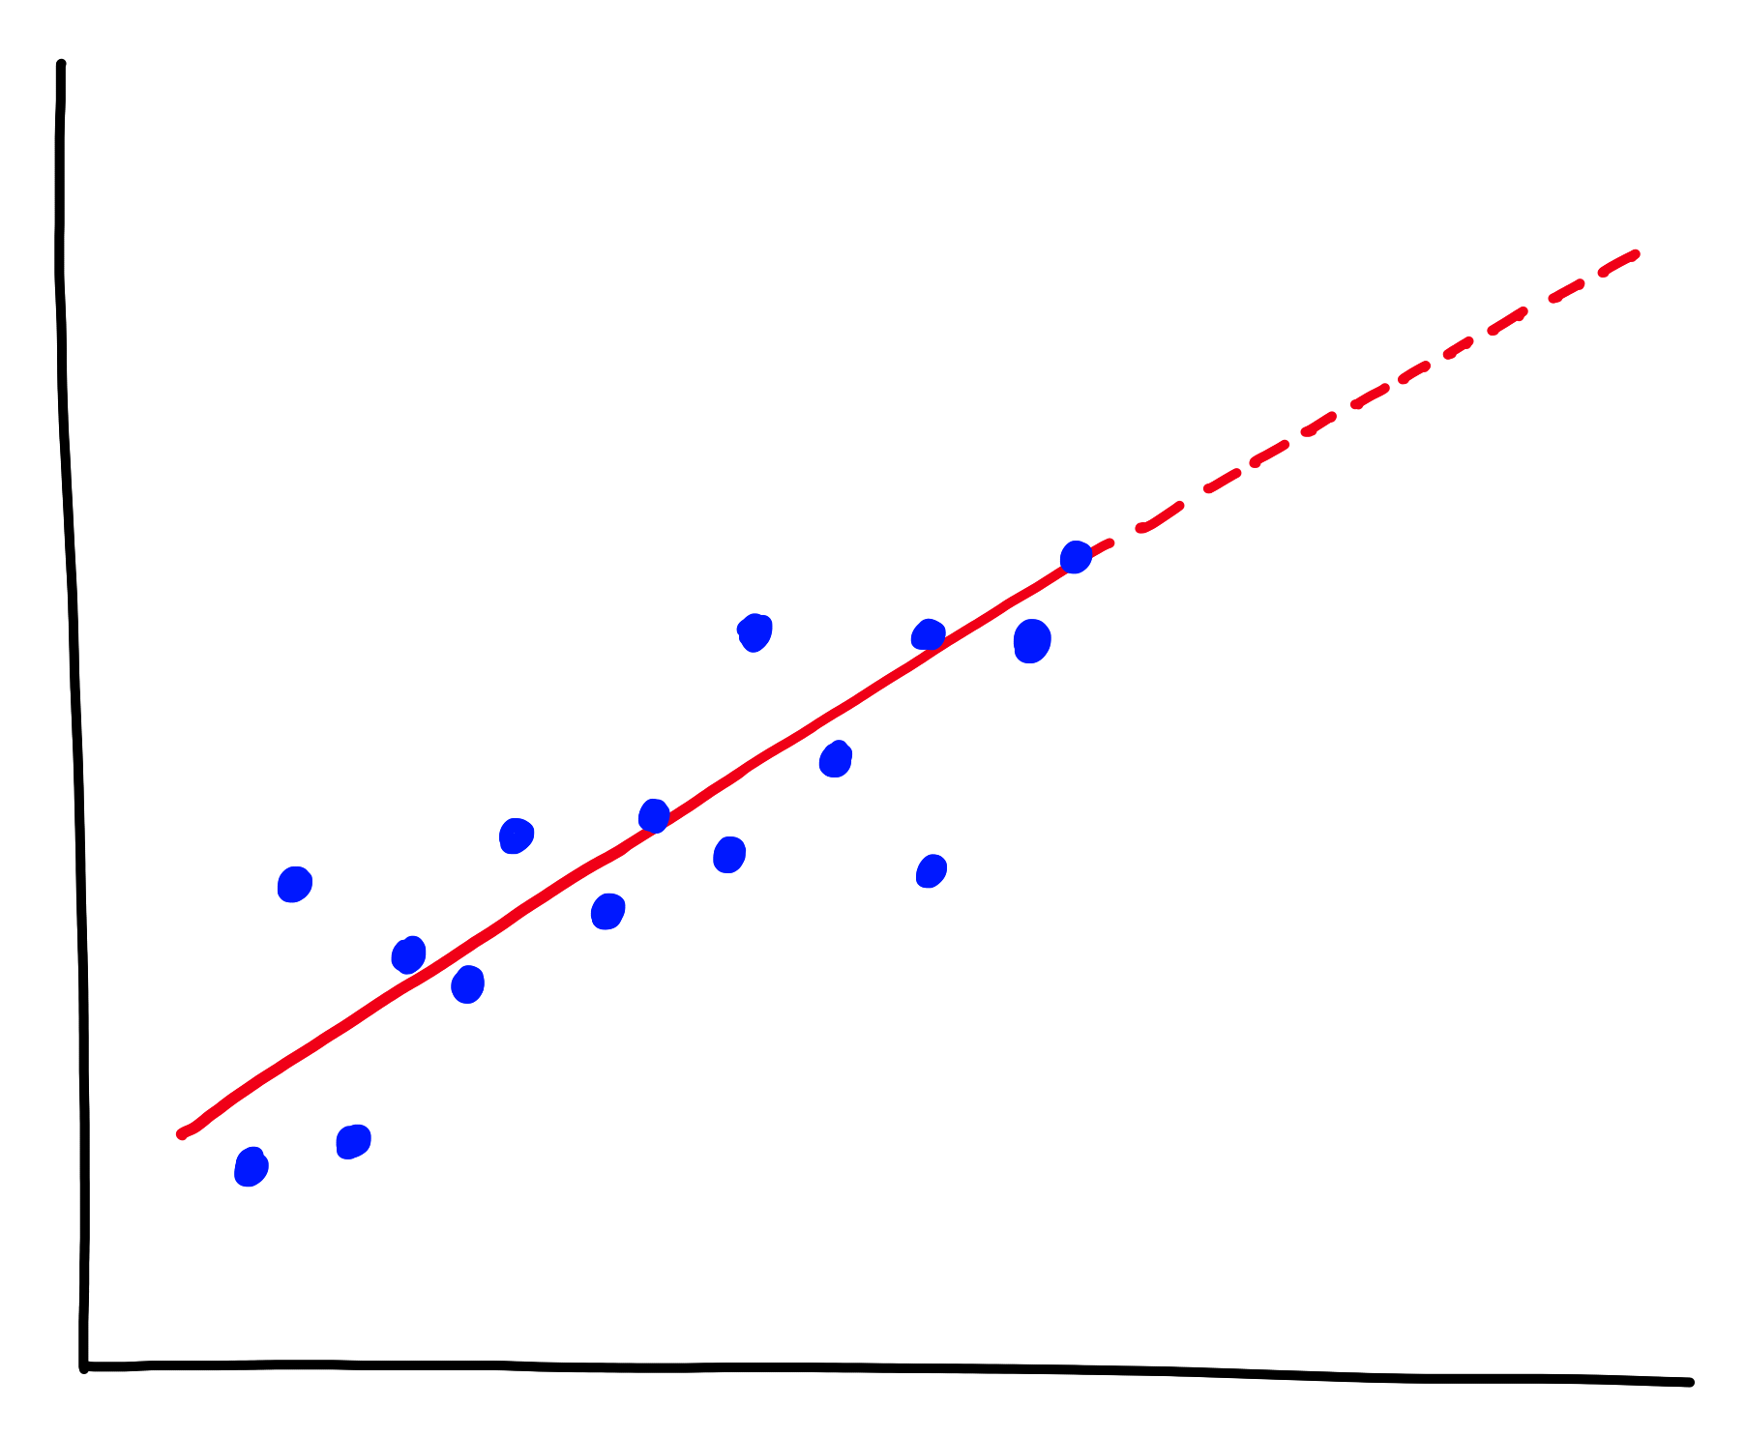
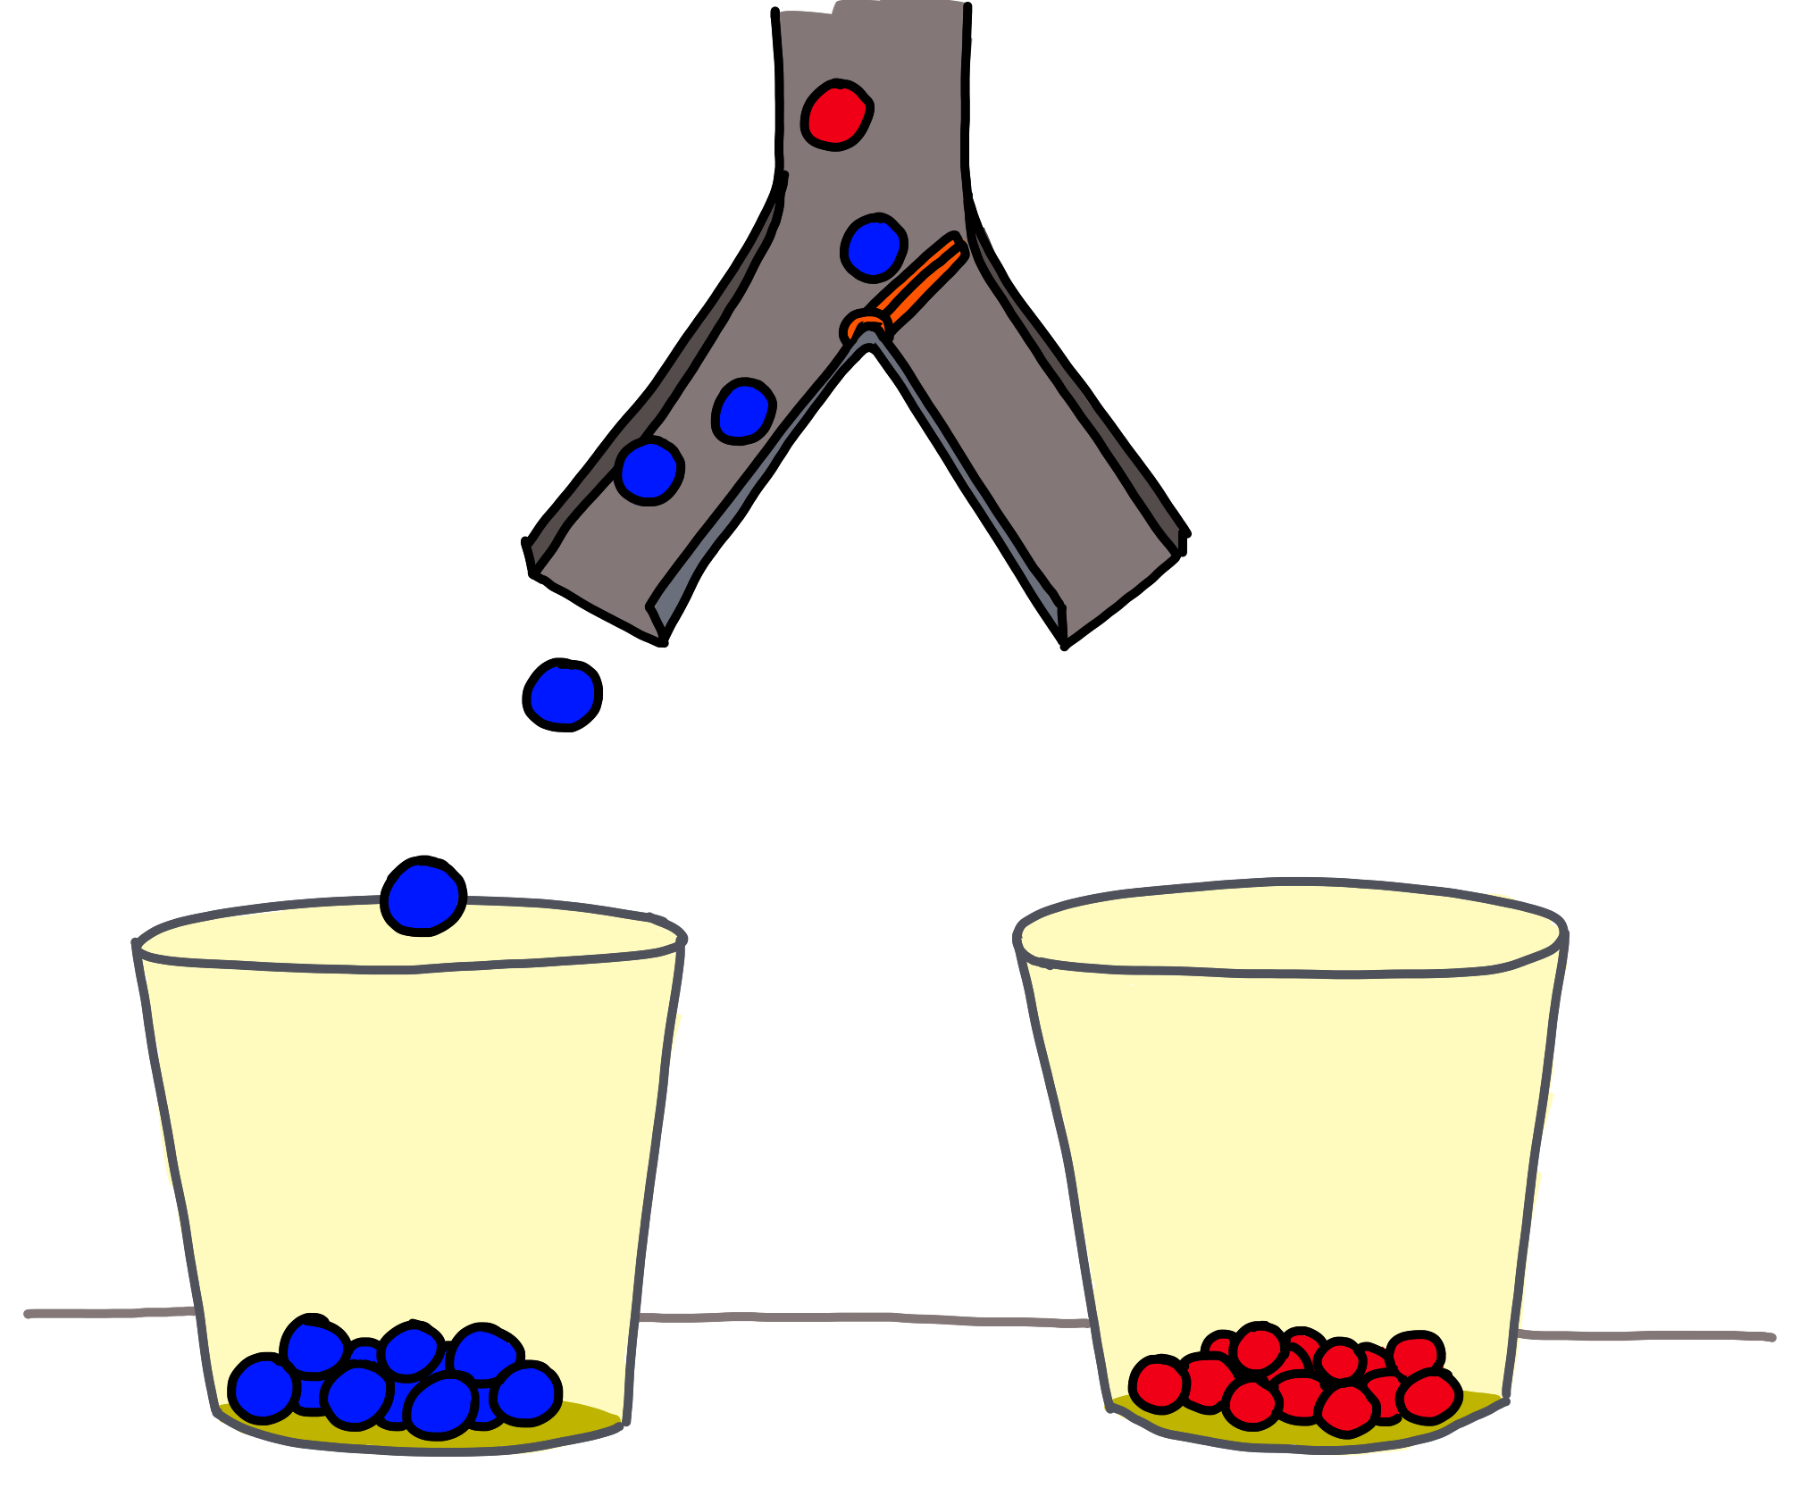
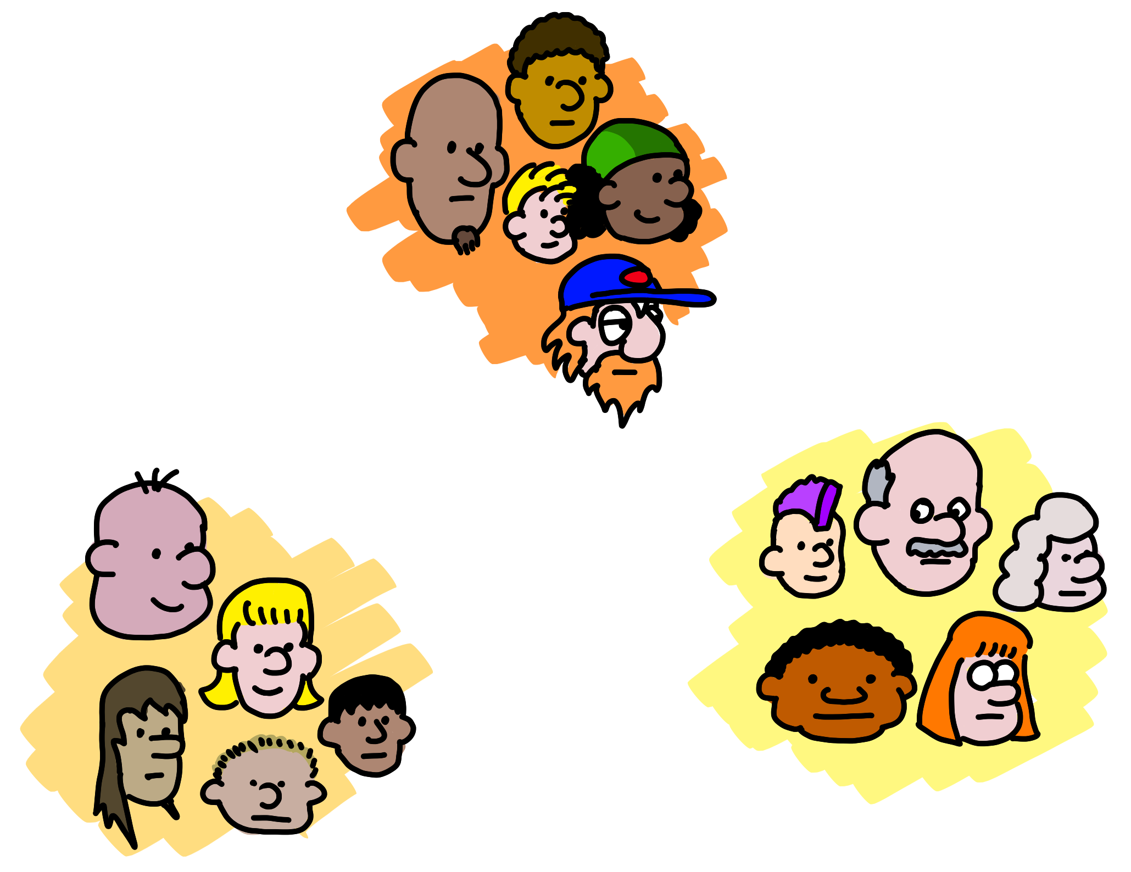
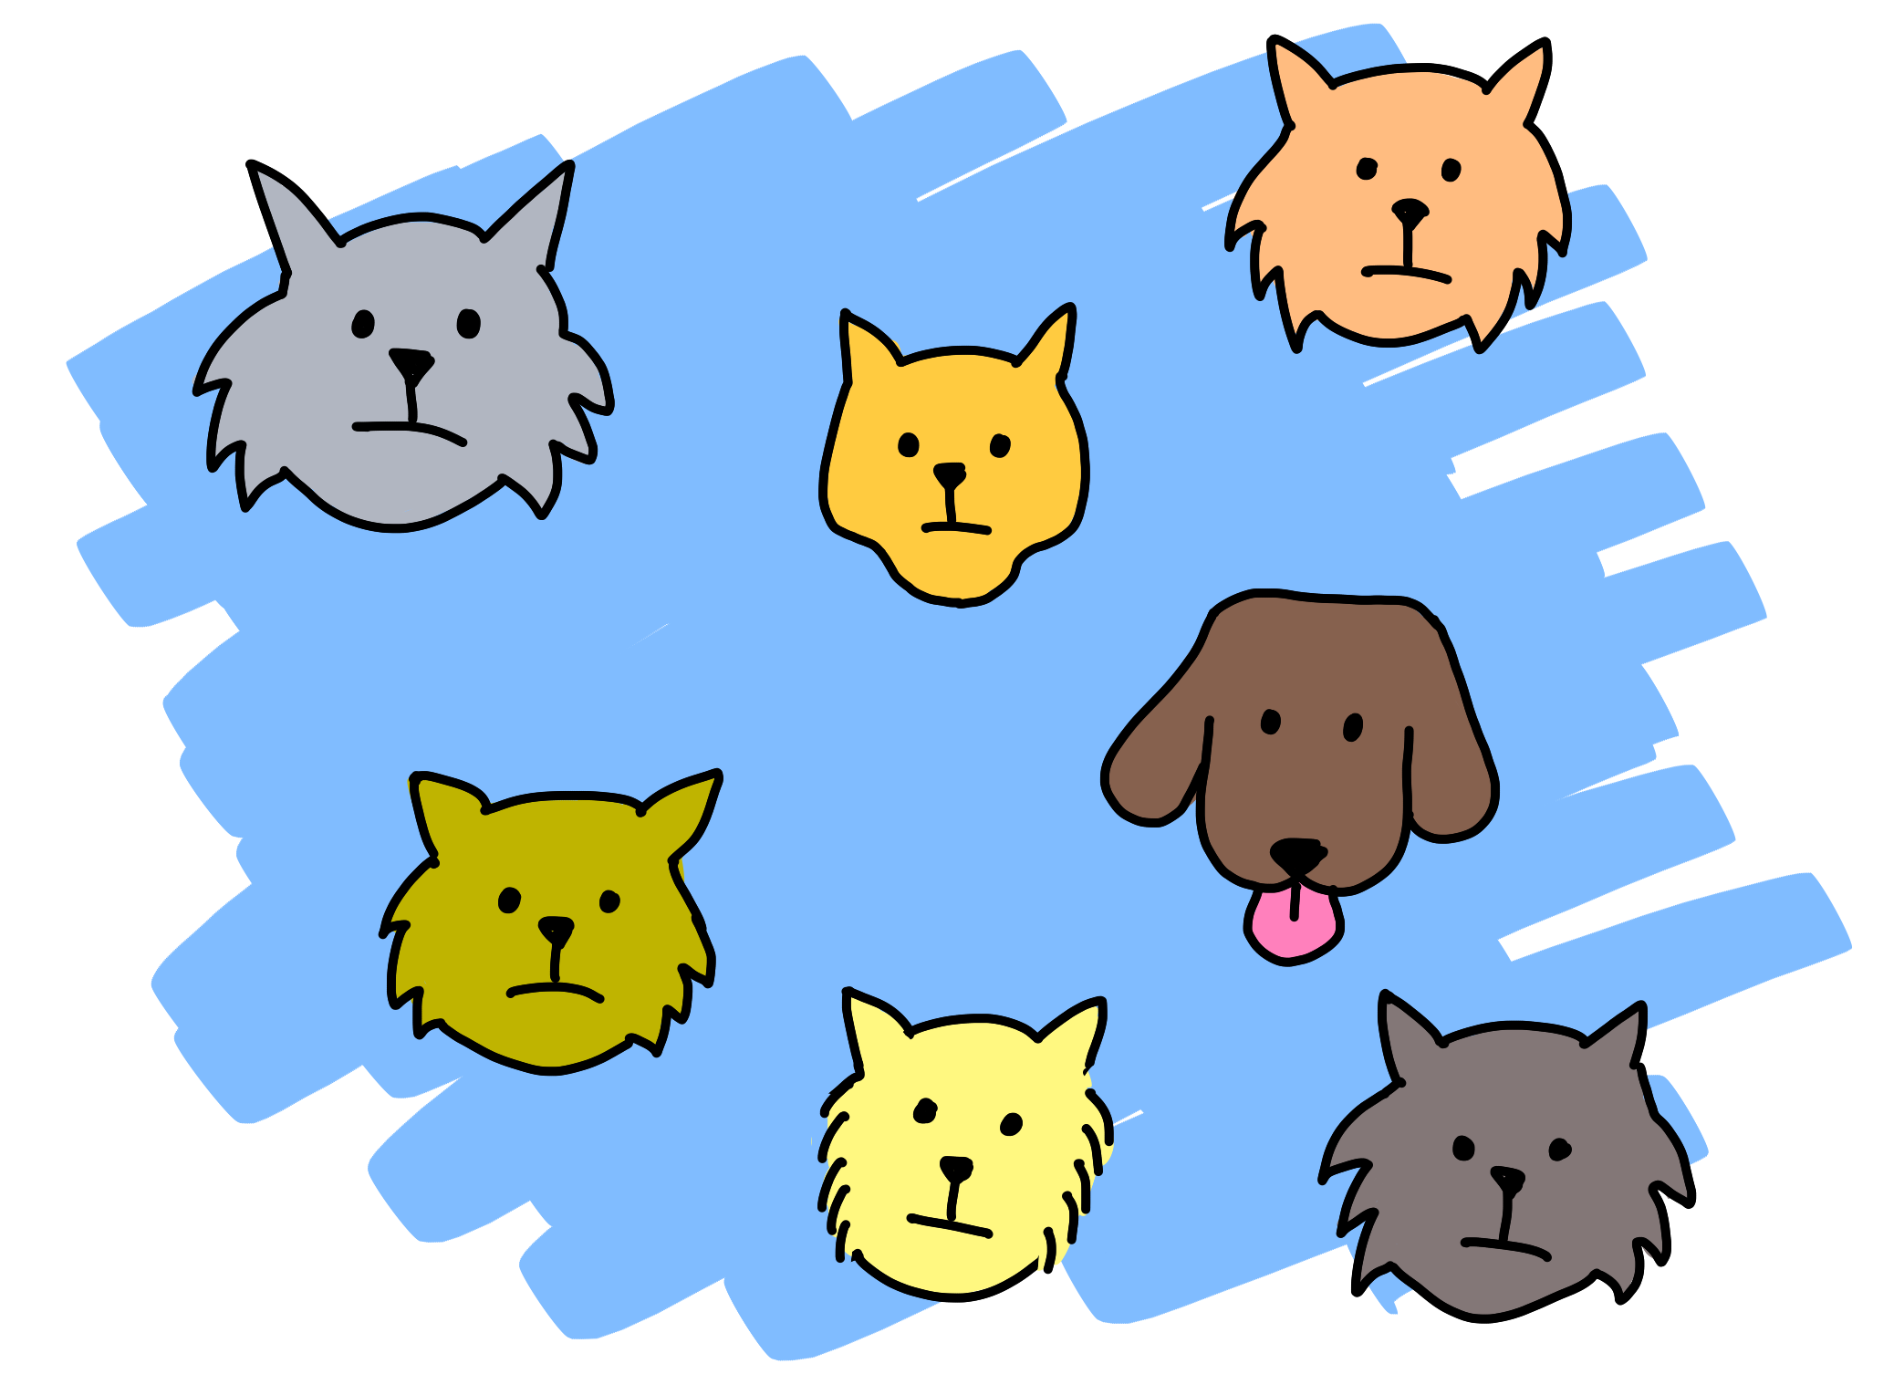
Predict how much/many
(Regression)
What next?
(Reinforcement Learning)
Which category?
(Classification)
Is it weird?
(Anomaly)
Data structure
(Clustering,
Recommender)
5 questions courtesy Brandon Rohrer
Notes:
The five classic questions you can answer with traditional ML
Classification: Assign a category to each item or data point. This might be to identify our healthy or diseased cells, the breed of a dog, or the type of food.
Regression: Predict a real value for new data given trends in tagged example, typically a number. We can use regression to predict sea level rise, the chances of a forest fire, or how many people will be born in a given year.
Anomaly: Identify when something unexpected happens. – Is this weird? This can help detect potential security risks or malware, or potentially cancerous cells
Reinforcement Learning: Take some appropriate action or next step. This is quite commonly what people think about when they envision AI – a computer beating a human at chess, being able to navigate a maze, or solve a puzzle.
Clustering/Recommenders: Get to the structure or layout of data. This is the rather famous “Customers who purchased this product also purchased this other product” style of recommender. Unlike classification, this is used when the groups aren’t known in advance.

Slide 7
It’s all enabled by machine learning…
Notes:
Machine learning is a subfield of Artificial Intelligence.
Technically, machine learning is a method of data analysis that automates analytical model building.
But we can think of it as a technique to train artificially intelligent systems without needing to be specifically programmed.

Slide 8
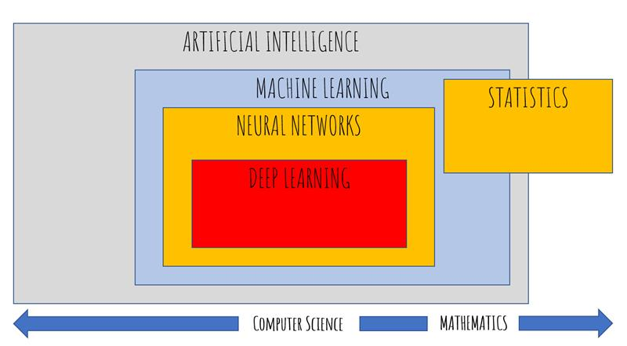
What’s the difference?
The overall field of AI includes ML, the use of neural networks and deep learning.
Machine Learning is a subset of AI, and it often involves creating models either built from scratch or built using pre-trained models
These fields encompass both computer science and mathematics in varying degrees
Notes:
So what’s the practical difference?
These terms are often used interchangeably, but it's important to be clear on what these terms mean.
AI is the overall field of creating intelligent systems. ML is a sub-field of AI where you can use data to train a model.
For our workshop, we will be focusing on AI, and one specific aspect – image classificiation.

Slide 9
Which category?
(Classification)
Notes:
We’ll be exploring classification today. Classification is the process of identifying which type an item is. One very common type of classification is image classification. We can use image classification to identify a type of animal (bird, dog or cat), a breed (poodle or pit bull), type of plane, etc.
While it is possible to build your own model from scratch, this is a common problem many people and organizations are looking to solve. As a result, products already exist which allow us to train a service which uses a pre-built model. We’ll then be able to use this service like we would any other cloud based service.

Slide 10
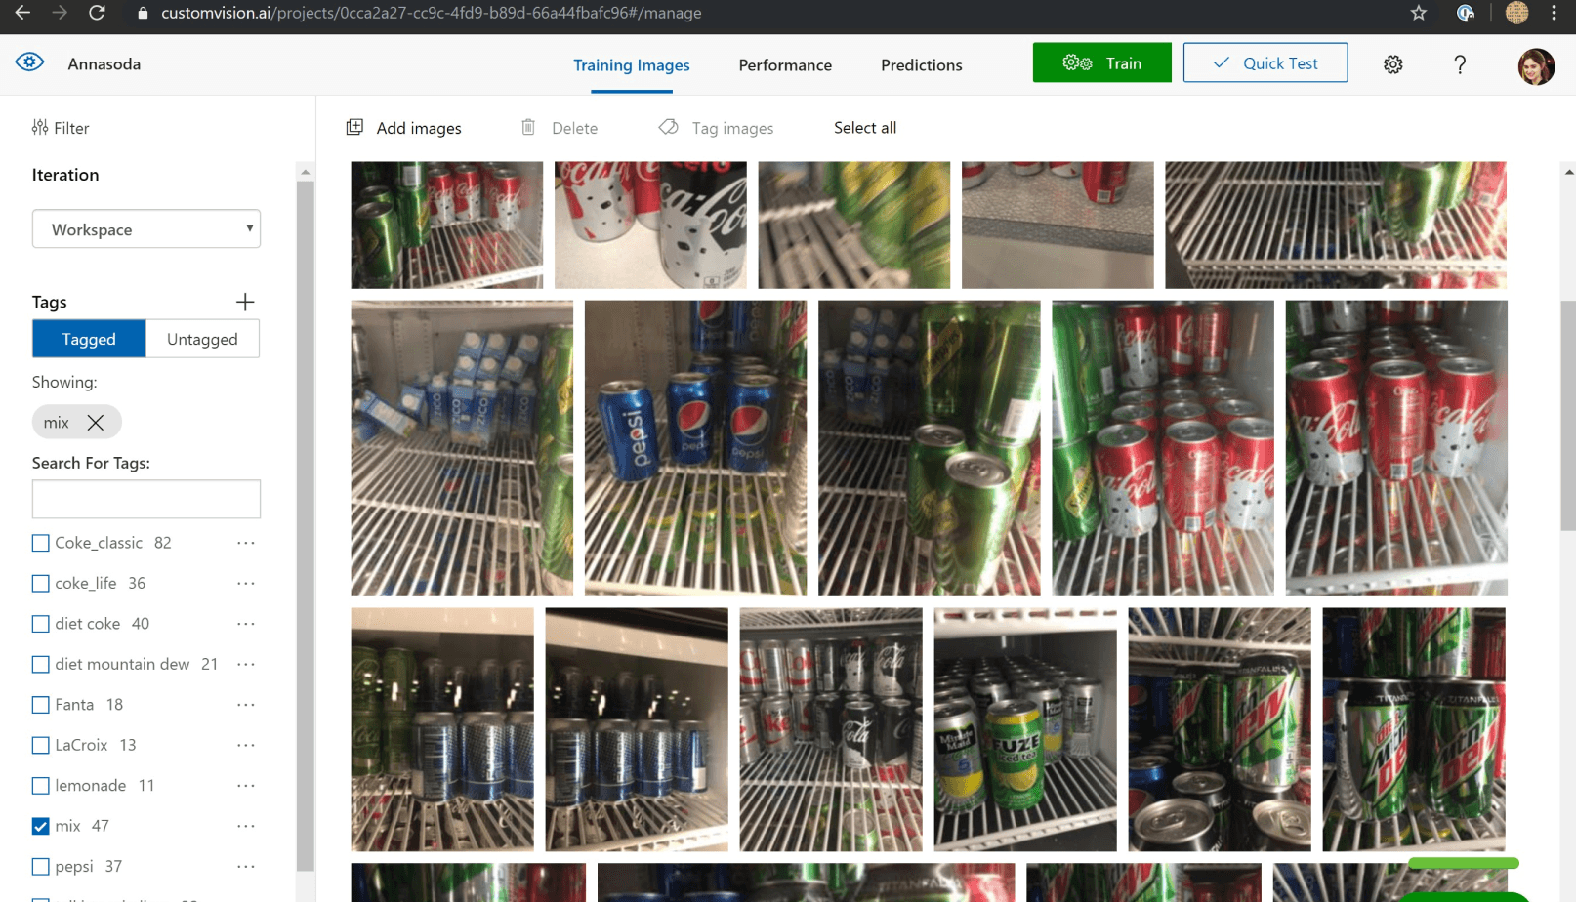
Introducing Custom Vision
Notes:
Custom Vision is part of Azure Cognitive Services. It’s a cloud based service which allows you to create a custom image classification model.

Slide 11
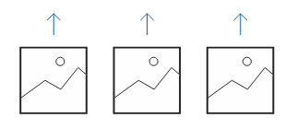
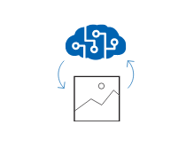
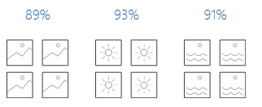
Your own custom vision model, in 3 steps
Upload and label your images
Train the model
Evaluate the results
Notes:
There are essentially 3 steps to create a custom vision model
Upload and label your images – which ones have cats, which ones have specific breeds, etc. The labels become the categories
Train the model in the cloud
Evaluate the results, and add images as needed

Slide 12
Exercise - Creating a Custom Vision Model
Notes:
Walk the attendees through the first set of steps for training and testing the model

Slide 13
Probability and AI
No model is perfect. The probability indicates how correct the model believes its answer is.
All models represent a "closed universe“
Your model will always try to match the image to what it knows.
There is always some level of uncertainty
All models will make mistakes and not be 100%. A probability score above 80% is commonly acceptable.
Improving accuracy
The best way to improve the model is to increase the number and diversity of images used to train. This includes different angles, settings, and lighting.
Notes:
Once the exercise is complete, your attendees may have questions about the probability and how the model works. This should help answer some of the most common questions.
All models are a "closed universe". This means it only knows what it's been trained on, and will **always** attempt to match an image to the tags it knows. This is why you might upload an image without a picture of a dog, but still have a result indicating a particular breed.
There is always some level of uncertainty. Just as we humans aren't always certain about different things, the model is the same. The level of uncertainty will depend on what you're trying to create, but 80% and above is a good general rule of thumb for having a useful model.
To improve the accuracy add more images and increase the diversity. This includes different backgrounds, lighting, angles, resolutions, etc.

Slide 14
Performing a prediction
After the model is trained, you can make predictions to determine which classification matches the image
Install the required packages
Azure Custom Vision has an SDK available in Python for making predictions.
Load the appropriate key values
To call your model you need its ID, name, and the key (password).
Perform the prediction
Use the SDK to upload the image to the model and perform the prediction.
Notes:
This slide walks through the three main steps to make a prediction. Start by introducing the SDK, and how it can be used to interact with the model. At a high level, a developer needs to install the appropriate packages (similar to any Python application), read in the values like the endpoint URL and key (or password), and finally perform the prediction.

Slide 15
Exercise - Using a Custom Vision Model
Notes:
Walk the attendees through the first set of steps for training and testing the model

Slide 16
What's next?
Learn about object detection
Creating custom models with TensorFlow

